Slide 1


Lecture 4 Immutable Collections
4.3.2023
Iflaah Salman

Slide 2
Collections
A collection is a single object representing a group of objects (such as a list).
The collection classes are often used as the basis for data structures and abstract data types.
For example, List, Sets.
A collection should be used when we want to associate some significant behaviour with the data in the collection.
For example, SortedList: to maintain some order despite adding and removing elements.
The Scala collections framework is defined within the scala.collection package and its sub-packages, split into mutable and immutable (data) structures
scala.collection.immutable once the collection is created, we cannot change its contents.
The collection types incorporate higher-order functions!

Slide 3
Collections: Key Design Principles
Ease of Use
Most problems can be solved with just a couple of operations
Concise
Use of higher order functions has made operations concise, e.g., foreach function.
Safe
The presumption of immutability and the avoidance of side effects make the use of collection types much safer in Scala.

Slide 4
Collections: Key Design Principles
Fast
Operations are tunned and optimised to maximise performance
Universal
A common set of operations exists across all the collection types; easy for developers from the learning perspective.
Expressive
The vocabulary that is used is expressive and semantically meaningful; helping developers to express the intent of their code.

Slide 5
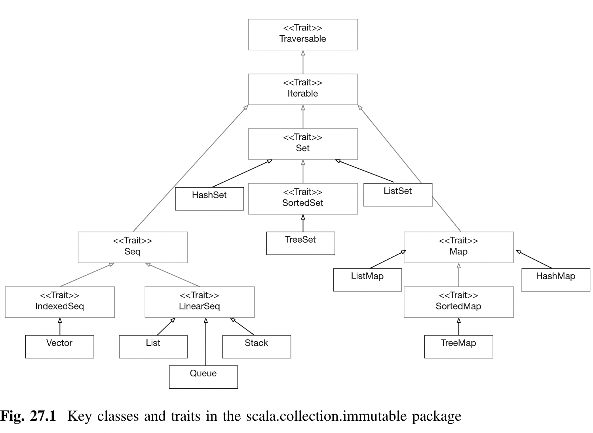
Trait
Traits can play in developing reusable behaviour that simplifies the development of new types.

Slide 6
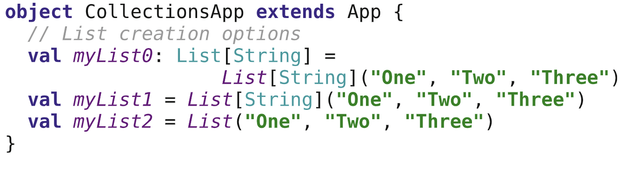
Immutable Lists
List
An immutable fixed sequence of elements
Constant time access to the first element and to the tail elements.
Other operations take linear time.
Provides the core Sequence like behaviours
A sequence is a collection in which there is a specific order to the elements it holds.
List creation options
Notes:
Lists are a very widely used collection as they provide all the core sequence-like behaviours.

Slide 7
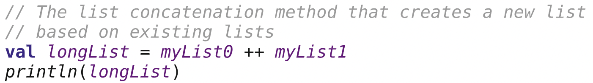
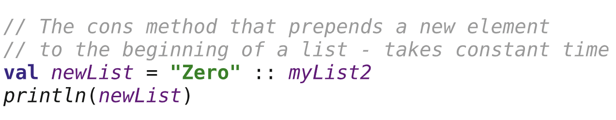
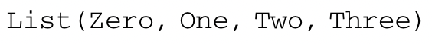
Immutable Lists
in the older versions of Scala the ‘:::’ operator was available instead of the ‘++’

Slide 8
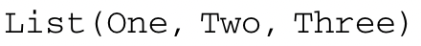
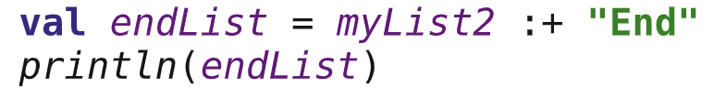
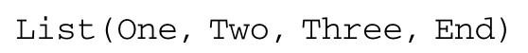
Immutable Lists
cons operator to construct a list from a set of existing values.
Value Nil at the end of the statement represents an empty list.
It is thus to this list that the strings “One”, “Two” and “Three” are being added.
any method or operation that ends with a ‘:’ is right-associative.
Thus the expression “Three” :: Nil must be read from the right to the left.
‘+:’ operator which again prepends an element to the front of the list and returns a new list. ‘:+’ operator to append an element to the contents of the existing list – takes linear time.
Notes:
Thus the String“Three”is being prepended to the empty list represented byNil. This expression then returns the new list containing the String“Three”. TheString“Two”is then prepended to that list by the next‘::’cons operation

Slide 9
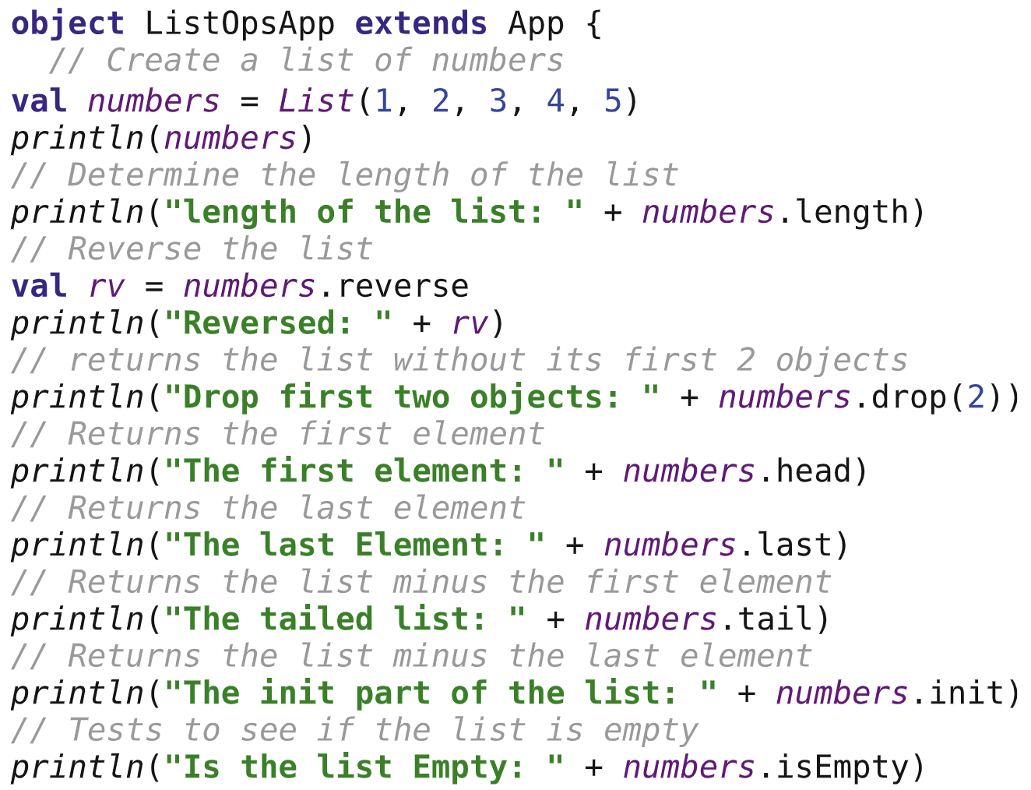
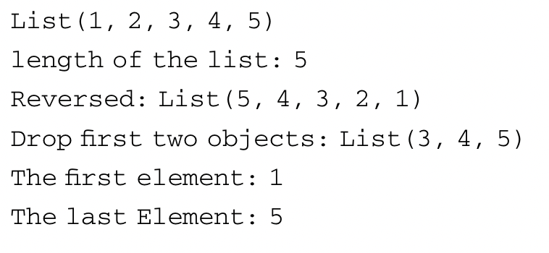
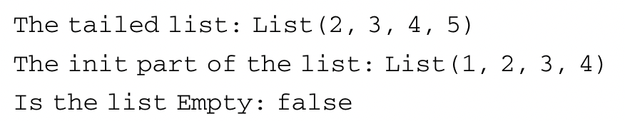
Immutable Lists
Notes:
Thus the String“Three”is being prepended to the empty list represented byNil. This expression then returns the new list containing the String“Three”. TheString“Two”is then prepended to that list by the next‘::’cons operation

Slide 10
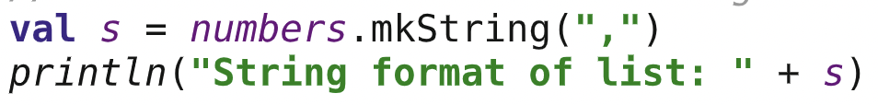
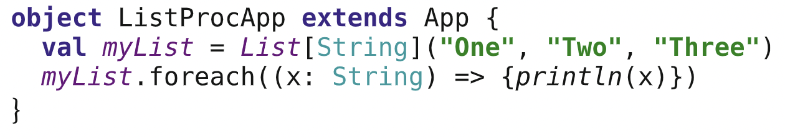
Immutable Lists
the .mkString method converts the contents of the list into a string.
each element in the list separated by the string passed into the method.
List Processing
We can process elements in the List because it is an iterable collection.
foreach is a higher-order function that can take a function to apply to each element in the List in turn.
Notes:
Thus the String “Three” is being prepended to the empty list represented by Nil. This expression then returns the new list containing the String“Three”. TheString“Two”is then prepended to that list by the next‘::’cons operation

Slide 11
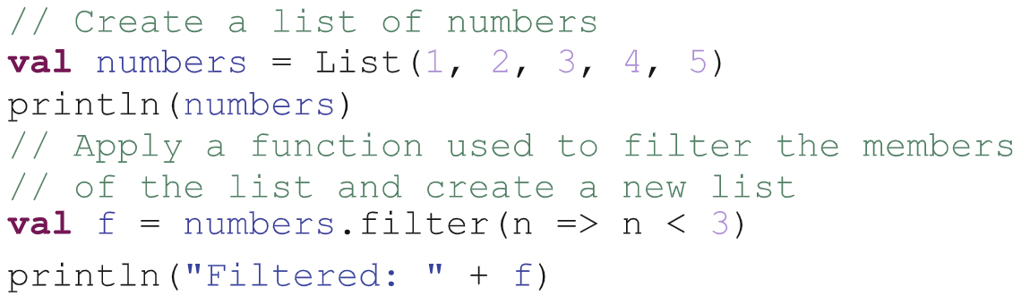
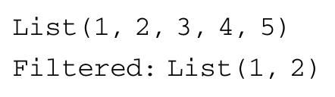
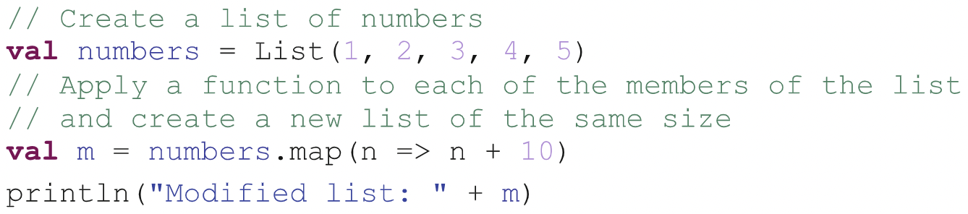
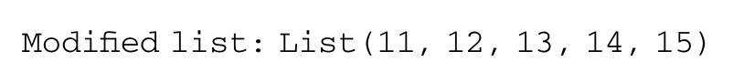
List Processing via HOFs
filter: to select only certain elements in a list that meet a specific criterion.
map: apply a function to each of the elements in a list and create a new list of the same size

Slide 12
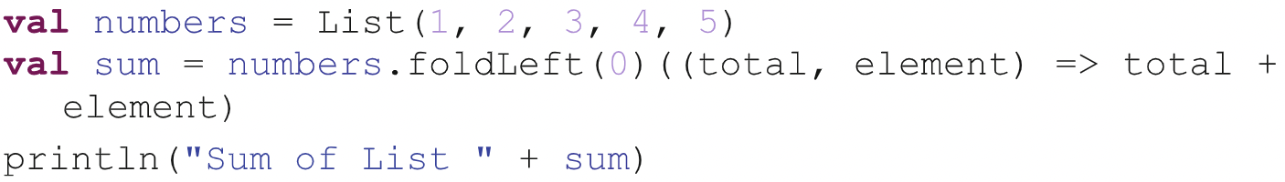
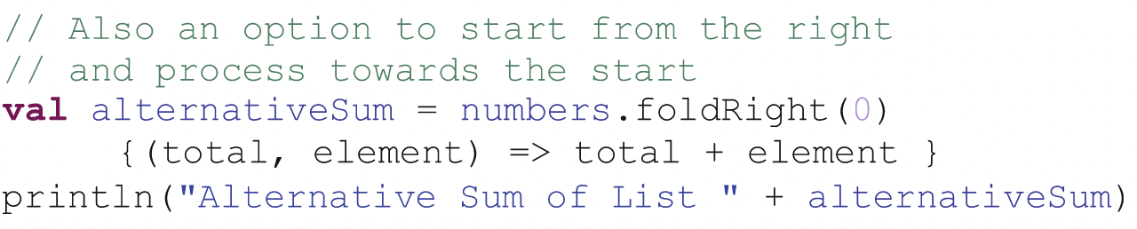
List Processing via HOFs!
foldLeft or foldRight: to apply a function to all the elements in the list and gather the results into a single value.
foldLeft is a multi-argument list operation
foldLeft operation takes an initial value (or state) and propagates with the result of one evaluation being passed as input to the next.
It starts from the leftmost element and processes towards the right end of the list.
The first argument takes the initial value to use and the second argument list takes the function to apply.
The result return from this function is then passed to the next invocation of the function.
foldleft is preferred over foldright when the lists are large. Therefore, it is better to reverse the list and apply foldleft
Notes:
foldleft result(): Sum of List 15
foldright() result : Alternative Sum of List 15

Slide 13
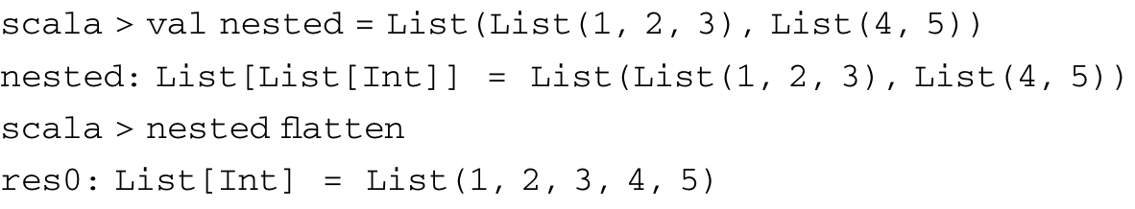
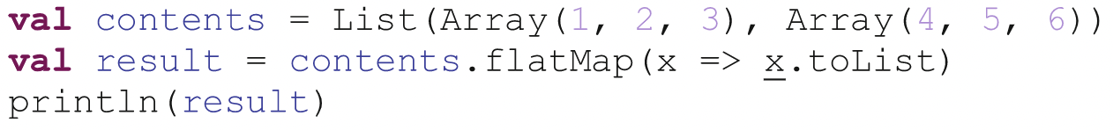
List Processing via HOFs!
flatten can be used to flatten a list.
given a list of Lists, it can return a single list.
flatMap is essentially map plus flatten
The function given to flatMap is expected to return a list of values.
flatMap is used to convert the array to a list and then to flatten the two lists into a single list.
Notes:
flatMap() result: List(1, 2, 3, 4, 5, 6)

Slide 14
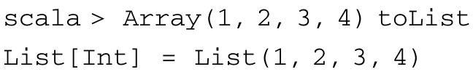
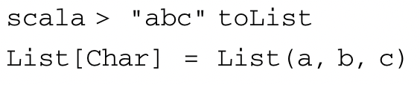
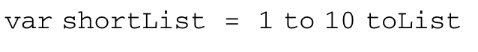
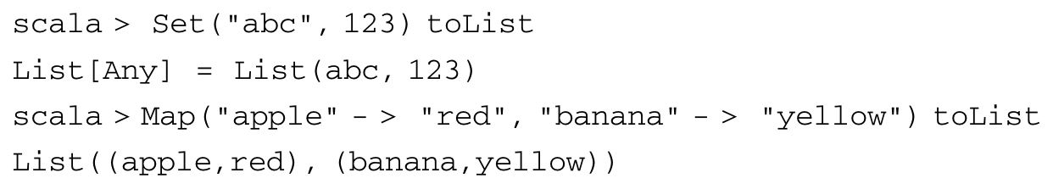
Converting to a List
Array to a List
String to a List
Generated sequence to a List
Set or Map to List
A Set does not allow a duplicate of an element.

Slide 15
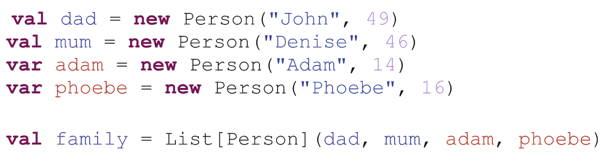
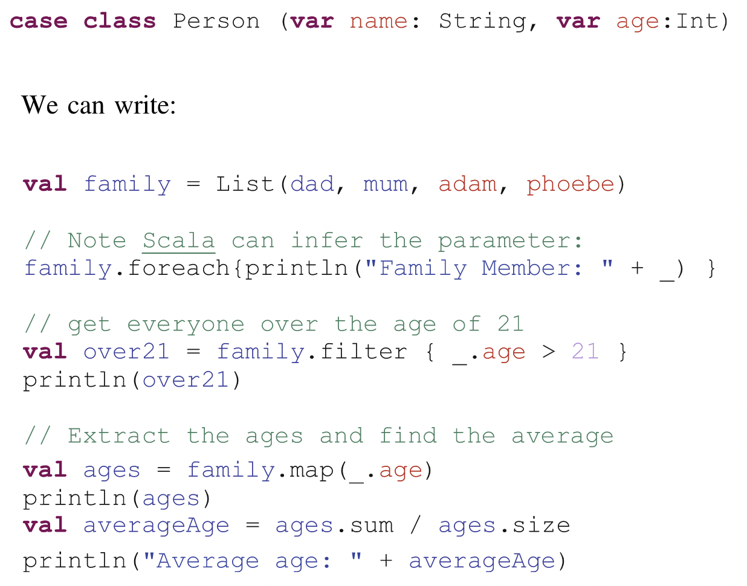
Lists of user-defined types!!
We can now also access the properties and methods defined in the class Person within the functions we apply to the elements of the list.
Notes:
Specific to Scala!

Slide 16
Immutable Map
A Map is a set of associations, each representing a key-value pair.
The values can be unordered and can be repeated, but every value has a key and keys are unique.
Some Map implementations, like TreeMap and ArrayMap, guarantee a specific order.
HashMap implementation does not guarantee a specific order.
It is a concrete immutable implementation based on Hash trie.
To find a given key in a map, the code first takes the hash code of the key and based on information held in the hash finds the appropriate bucket into which the key-value pair would have been placed.
Hash trie strikes a balance between reasonably fast lookup and reasonably efficient inserts and deletions.
hash trie can refer to: Hash tree, a trie used to map hash values to keys.
Source: wikipedia

Slide 17
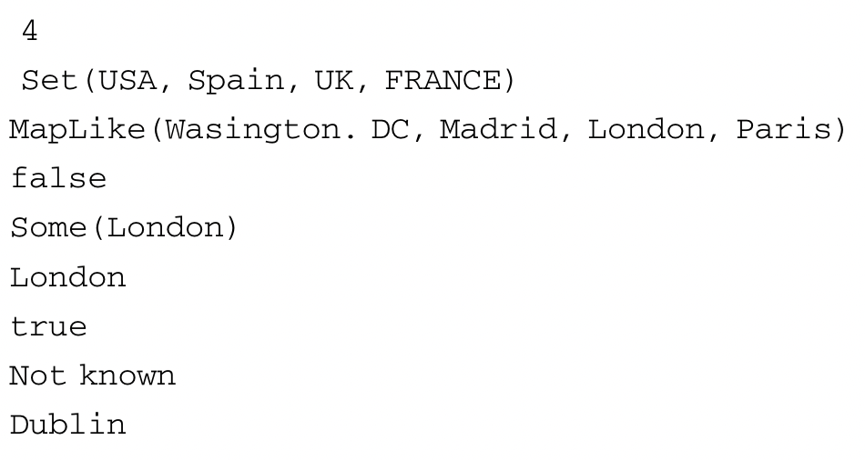
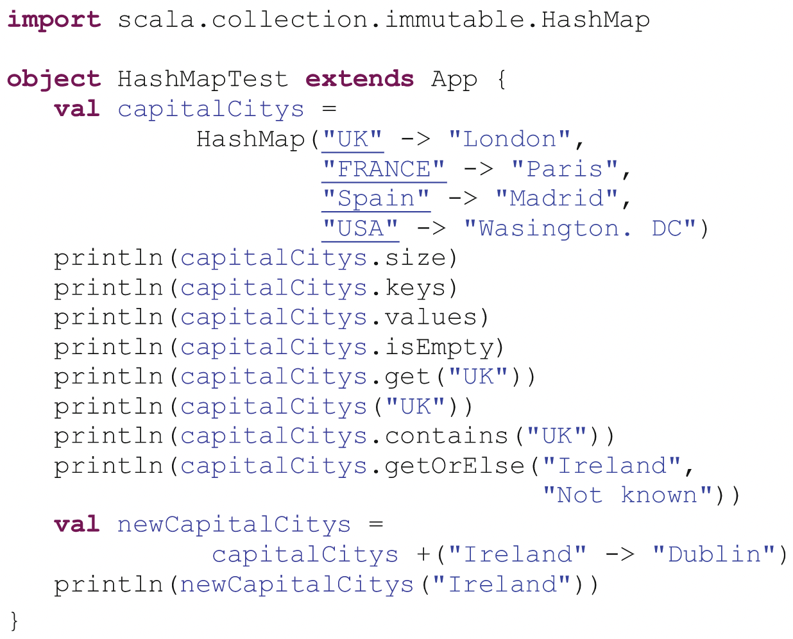
HashMap
The keys are returned as a Set as they will be unique.
The Values are returned as a type of sequence as there may be duplicates.
The method get and the access (nth) are often treated as synonymous, but they have different return types. get may return None, but access will throw an exception.
An alternative to get or access is getOrElse.

Slide 18
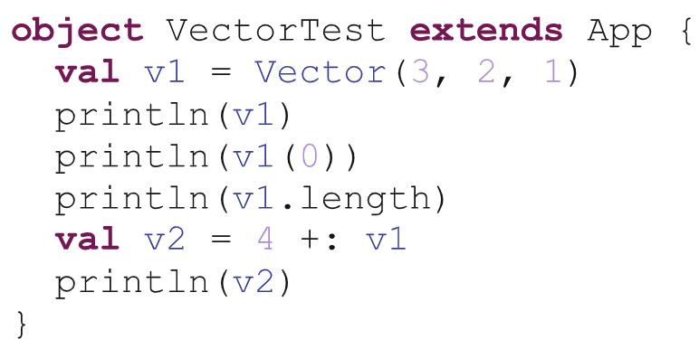
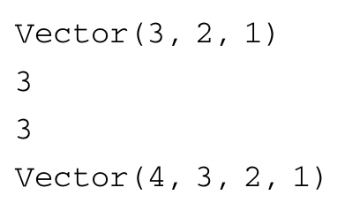
Sequences
Vector
A general-purpose immutable indexed sequence.
you might choose to use a Vector over a List as it provides faster access.

Slide 19
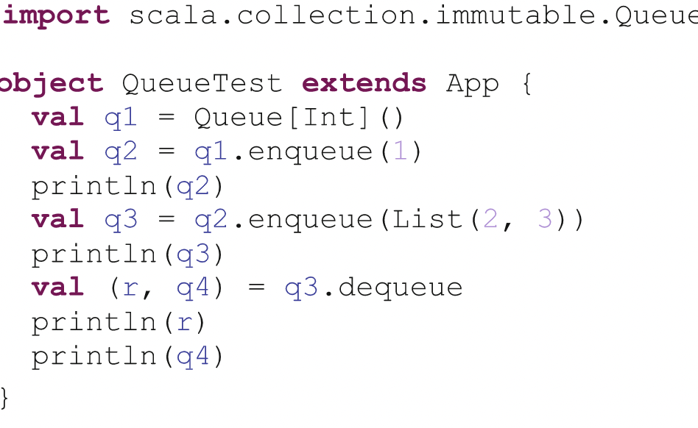
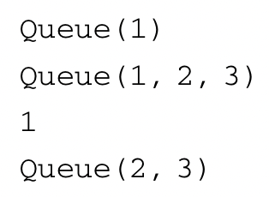
Sequences
Queue
A Queue is a first-in first-out (FIFO) type of collection.
Primary methods are enqueue and dequeue.
return a copy of the original queue with a new element added or an element removed.

Slide 20
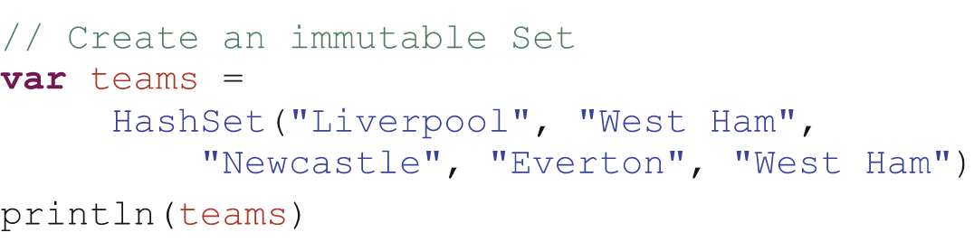
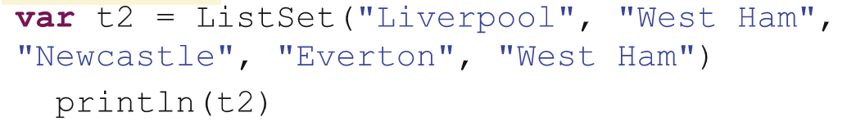
Sequences
Set
HashSet is an immutable Set implementation based on a hashing function.
Only allows a single instance of an element in the Set.
ListSet
set using a list-based structure internally
Or a List that restricts the occurrences of some element to a single occurrence.

Slide 21
Sequences
Maps
ListMap
a map that uses a linked list-based structure to internally represent the key-value pairs
Operations on a list map take linear time relative to the size of the map.
hashMap is a better choice.
HashMap
collection of associated keys and values that are organized based on the hash code of the key.
TreeMap
Implements the map as a tree structure.

Slide 22

References
Hunt, J. (2018). A Beginner’s Guide to Scala, Object Orientation and Functional Programming. In A Beginner’s Guide to Scala, Object Orientation and Functional Programming. Springer International Publishing. https://doi.org/10.1007/978-3-319-75771-1

